Slide 1
Performing classification on edge nodes using Edge-centric Distributed Deep Learning
By Manan Khasgiwale and Vasu Sharma

Slide 2
Motivation
Rise in IoT devices causing an enormous increase in data
Analyzing enormous data can provide convenient use cases for end users
Traditional applications use cloud servers for these heavy inference tasks
Leading to network congestion and higher latencies for many real-time applications
Real time applications like face recognition or human activity recognition demand quick inference output and lower network load

Slide 3
Recent Studies
Aimed at using edge as a complementary resource for the cloud
Some are aimed at using edge for DL training and inferencing
Faces multitude of challenges – limited computation resources, memory footprint and energy consumption at the edge
Some approaches – Distributed Deep learning over the edge
Some approaches – Containerize different parts of DNN
Some approaches – Data reduction at the edge

Slide 4
Approach
Selecting a DNN model best suited for HAR (Human Activity Recognition)
Time series data
Accuracy
DNN model compression
Pruning
Quantization
Comparing inference latencies between cloud and edge servers
Average latency over all samples of test data

Slide 5
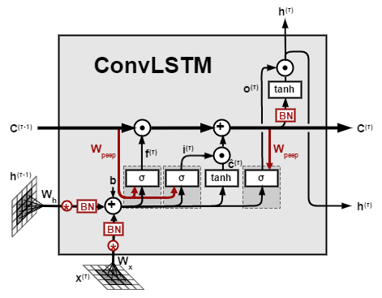
Selecting a DNN model best suited for HAR
Input to the model is sliding window over time series data
To utilize the time series nature of the data, we went ahead with a LSTM model
Use input, output and forget gate to work with the hidden and the context layers.
LSTMs can be useful in a time series setting
A CNN model would be able to get a better representation of the time series data due to the correlation between the nearby sensor signals in the data.
Combining the recurrence provided by LSTM and feature representation provided by CNN
The convolution is performed at each time step as part of the input
Notes:
The accuracy and latency measurements are carried out on both scenarios in order to find a better fit for the task of HAR.

Slide 6
DNN model compression
Pruning
Network pruning is used to trim the neural network to reduce the cost(time) of inference.
Helps save space needed to store the complete model
Prevents model from overfitting.
Quantization
Post training quantization which involves reducing the precision of weights resulting in lower model sizes

Slide 7
Dataset
UCI HAR Dataset
Dataset consists of six activities (WALKING, WALKING_UPSTAIRS, WALKING_DOWNSTAIRS, SITTING, STANDING, LAYING)
Captured via smartphone (Samsung Galaxy S II) at 50 Hz
The obtained dataset has been randomly partitioned into two sets, with 70/30 train/test split.
Sampled in fixed-width sliding windows of 2.56 sec and 50% overlap (128 readings/window).
Training dimensions
Input = (7352, 128, 9)
Output = (7352, 6)
Test dimensions
Input = (2947, 128, 9)
Output = (2947, 6)

Slide 8
Results and Evaluations
Model name | Accuracy | Model Size
ConvLSTM model | 91.562 % | 3.5 MB
LSTM model | 90.499 % | 1.6 MB
Pruned with Keras | 90.498 % | 1.1 MB
Pruning and post-training Quantization | 90.432 % | 69 KB

Slide 9
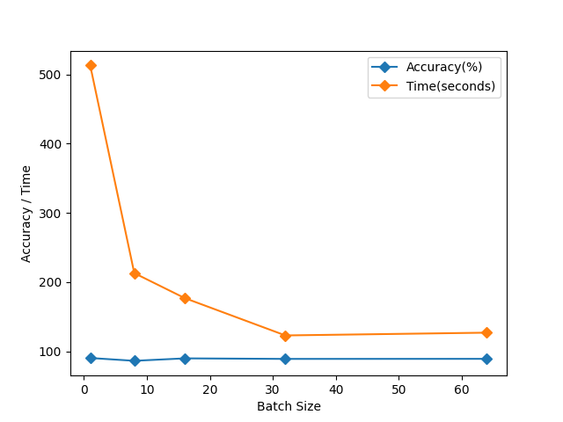
Results and Evaluations
With selecting LSTM as our model, we explored with different batch sizes for the input.
Accuracy remains constant across.
Training takes the least time for 64 batch size(weight updation).

Slide 10
Cloud vs Edge model comparison
Cloud server
Machine deployment :- us-central1-a (Iowa)
Machine specs :- c2-standard-8 (4v CPU, 16GB memory)
Edge server
Machine deployment :- Local network
Machine specs :- i5 8th gen (quad core), 8GB
Environment | Type of model | Average Inference Time (ms) | Average Invoke Time (ms)
Edge Server | Compressed LSTM | 5.005 | 4.45
Cloud Server | Uncompressed LSTM | 124.123 | 43.37
Cloud Server | Compressed LSTM | 40.260 | 4.04

Slide 11
Future Work
Data dimensionality reduction
Comparing the model inference latency after applying autoencoders for dimensionality reduction.
DNN model splitting framework
Splitting based on the runtime of the layers involved in the network
Using a framework like Couper which identifies the candidate split points of the input DNN model and finds the most efficient representation. Still not open-sourced
Weight Clustering
Clustering, or weight sharing, reduces the number of unique weight values in a model, leading to benefits for deployment. It first groups the weights of each layer into N clusters, then shares the cluster's centroid value for all the weights belonging to the cluster.
Currently LSTM or ConvLSTM layer is not supported for weight clustering
Applying the compression techniques for a ConvLSTM layer

Slide 12
Thank you! Questions?

